Slide 1
Breaking into industry with a non-STEM degree
LINGUISTS IN TECH: CLOSING THE SKILLS GAP (GENEVA, 21-22 APRIL)

Slide 2
“Pour faire quoi après ?”
LINGUISTS IN TECH: CLOSING THE SKILLS GAP (GENEVA, 21-22 APRIL)

Slide 3
”I’m hoping to marry a millionaire”
(But was I really?!)

Slide 4
Roadmap
My profile
My journey
What I’ve learnt about:
Life after Uni
Upskilling
Industry
Networking
Tips to (hopefully) make your journeys less rocky.

Slide 5
Me, in a nutshell
Volleyball
BA and MA in theoretical linguistics (Venice)
Doctorate in general linguistics (Geneva)
2 postdoctoral appointments (Cambridge)
Services Data Scientist (Five9)

Slide 6
3
What to study
Life after graduation
Life after PhD
Research
Industry?
PIVOTAL CHOICES

Slide 7
The three big choices
Staying sane in a confusing world

Slide 8
1. UNIVERSITY (don’t listen to what people say)
“Will you please leave me alone??!!”
“Pour faire quoi après?”
“Don’t study Spanish, German is way more useful”
“What’s the point in studying languages in university? I learnt German when I moved to Hamburg for work and I speak very well”
“Your French is already good, why pay to study it in Uni?”
“You are smart, you should have study to become a surgeon”

Slide 9
1. UNIVERSITY (study what you love)
“Find a job that you love, and you will never have to work a day in your life” (Confucius? Mark twain?)
“Life is what happens while you’re busy making other plans” (Beautiful Boy, John Lennon)
“A passionate historian is better than a sad mathematician”

Slide 10
1. UNIVERSITY
BA in Linguistics MA Theoretical Linguistics
(Didactics) (Creole grammar)
Immediate goals: Learn French and English well, work on topics you love.
Professional goals: NONE.
You don’t have to have your whole life figured out in your 20s.

Slide 11
2. LIFE AFTER GRADUATION
Not yet, no.
“Are you going to find a real job, now?!”
But I did try, though!

Slide 12
2. LIFE AFTER GRADUATION
What (I thought) were my only professional choices back then
Non-academic PhD
teacher; had to be fully funded;
translator; had to be on Creoles.
proof-reader;
editor?
(but there’s so so much more!!!!)
(of English)
✅
❌

Slide 13
2. LIFE AFTER GRADUATION (looking back)
Being done with school doesn’t mean you’re job worthy/ready.
2 main mistakes:
Lack of flexibility (Doctorate in Cambridge)
Common misconception that graduation = end of studies
Up skilling/specializing is always a smart move!

Slide 14
3. LIFE AFTER A PHD: ACADEMIA 🙂
PhD in Theoretical Linguistics (Northern Italian interrogative syntax)
I stayed in academic research (I liked it + I thought that was my only choice)
Blessed with 2 consecutive SNSF scholarships to work at the University of Cambridge

Slide 15
3. LIFE AFTER A PHD: ACADEMIA 😭
Precarity
Lack of roots (international mobility)
Overwhelming competition (600)
Huge turning point

Slide 16
3. LIFE AFTER A PHD: INDUSTRY 😍
Tech is so cool!
Why not give it a try?
“In Data Science, we do so much text mining and text analytics it would just make sense to have linguists in the role, why don’t you give that a try”
(Marco De Ieso, Senior Data Scientist @ IBM)

Slide 17
3. LIFE AFTER A PHD: UP SKILLING 🫠
Identification of my skill gaps (applies to me, you, STEM graduates)
Retraining (Nanodegree @ Udacity + Bootcamp in ML)
Experience (Open Source co-operations at Omdena, Stability AI etc.)

Slide 18
3. LIFE AFTER A PHD: UP SKILLING 🫠
!!! Imposter syndrome alert !!!
Are people going to want a non-STEM
Graduate in a technical role?

Slide 19
3. LIFE AFTER A PHD RECEPTION OF MY UNUSUAL PROFILE
People were thrilled to see a linguist wanting to break into DS/NLP
My experience in academic research was highly appreciated
No one was treating me like a junior (but you will, if you’re a fresh graduate)
Job opportunities came at me more than I had to look for them

Slide 20
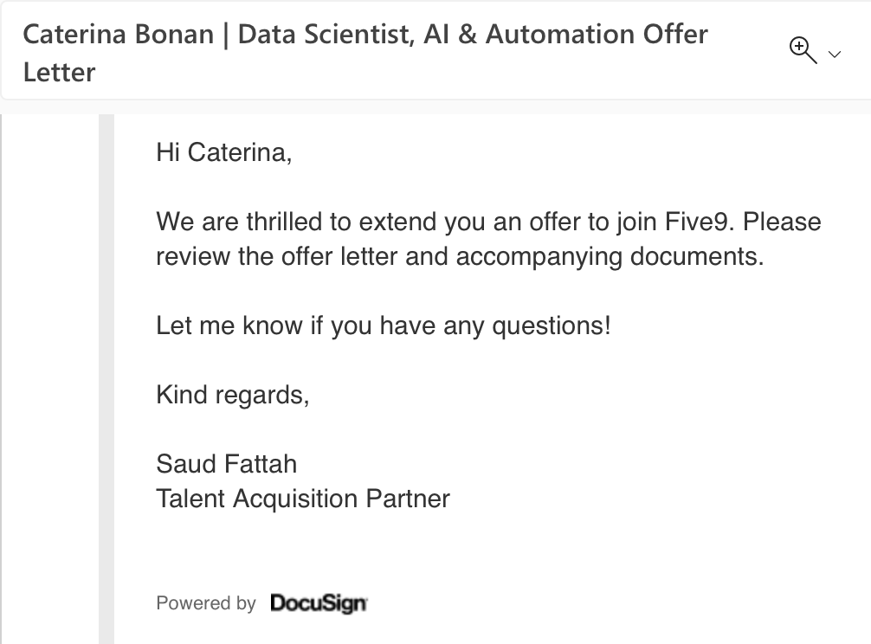
3. LIFE AFTER A PHD: THE JOB OFFER 🥳

Slide 21
3. LIFE AFTER A PHD: MY JOB AT FIVE9
Creation of IVAs
My role
Analysis of conversational workflows to help them shape and improve the product
Research to help them improve their voice offer
What I like about it
Permanent and well paid
Combination of my knowledge of linguistics, research skills, and the tools I learnt when upskilling
I feel trusted and valued
The career growth opportunities are endless

Slide 22
3. LIFE AFTER A PHD (looking back)
Big misconception: As someone who holds a doctorate in a non-STEM discipline, academia is your only choice.
“No one wants to hire people with PhDs because they cost more while lacking work experience” (literally everyone)
“No one wants to hire people with PhDs who are not able to show proactivity and readiness to learn and adapt to a different industry”
Up skilling/specializing is always a smart move!

Slide 23
Up skilling
I’ll discuss technical roles here, but most claims apply to all possible roles (project management, human resources, etc.)
All the whens and hows and whys

Slide 24
Why should I up skill?
Regardless of your field of studies, university will have equipped you with a solid knowledge base, but little practice
Some roles you’ll compete for in 5 years are not even being offered as Uni degrees now (when I studied: Data Science, Data Engineering, AI Ethics…)
The job market is insanely competitive – practical skills will make you one of the most attractive candidates
Demonstrates a pro-active mindset (highly valued!)
Will allow you to compete for higher paying roles (personal: 200%)

Slide 25
When should I up skill?
The earlier the better
While you’re still studying (dedicate 20% of your time to up skilling – over 2/3 years this will make a HUGE impact)
While you do an internship (low paying jobs are worth more in your CV than career gaps!)
Depends on your personal situation (Do you need to work to finance your studies? Do you have dependents?)

Slide 26
How should I up skill?
Identify the job you want (within reasonable means)
Research the job you want
Address most technical gaps (skills, certifications, experience)
Acquire hands-on experience (personal projects, bootcamps, open source co-operations)
As a junior aspiring for a technical role, you’ll almost certainly go through rounds and rounds of technical interviews
It’s never too early!

Slide 27
Hands-on experience will boost your CV

Slide 28
My two cents
How to navigate UNI AND WORK as a young person

Slide 29
How to navigate Uni (and stay sane)
Study what you like, not what people think is useful/sexy
Market trends change quickly
You don’t need a degree in X to work in X
If you want to do a PhD, do a PhD
A PhD will make you an attractive candidate
Your unique skillset will be highly valued
Yes, you’ll be paid more (and that’s a good thing!)

Slide 30
How to navigate your early professional years (and stay sane)
Constitutes your knowledge base, will probably determine the field you work in
get a degree
up skill
network
research the market
Makes you attractive
Makes you less naive
This is where opportunities come from

Slide 31
How to navigate your early professional years (and stay sane)
Don`t you ever think that holding a degree makes you job ready
Upskill
Acquire hands-on experience
Build a presence
Identify a field you want to work in / dream job (but stay flexible!)
Stay humble, but know your worth
Research your market value
Be ready to discuss the unique set of skills that makes you a great candidate
Be patient, you’ll have that dream job sooner or later

Slide 32
My invitees
LINGUISTS IN TECH: CLOSING THE SKILLS GAP (GENEVA, 21-22 APRIL)

Slide 33
From theoretical linguistics to ML engineering
Aleksandra Verkauteren
Senior Machine Learning Engineer and Head of NLP @ Metamaze
22 April 2023, 1:30pm

Slide 34
What does it take to work in tech today?
Janine Aeberard
Effi Georgala
Lonneke van der Plas
Linguistic Director @ Textshuttle
Manager II NLP Research @ Nuance Communications
Group Leader @ Idiap
22 April 2023, 1:30pm

Slide 35
Thank you!
And good luck figuring out what you want to do 🙂

