Slide 1
Guess the Language! Understanding the code
By:
Marie Berthouzoz, Margherita Pallottino, Genoveva Puskas
Topic 2, Class 3

Slide 2
The code:
The game was made using HTML, CSS and JavaScript.
These are the most basic languages used for creating Web pages today, making the game playable using any browser on any computer.
HTML files are used for the architecture of the game like, for instance, the structure of the homepage, the cards, the “materials” page.
The CSS file provides the visual styling of the page: colors, fonts, spacing, etc.
JavaScript is used to realize all the interactive elements of the game, like flipping cards and the reasoning of your artificial opponent. The game was programmed with the help of two JavaScript libraries called CreateJS and Sweet Alert.

Slide 3
The components of the code 1/3
index.html
Go to: instructions.html
Go to: play.html
style.css
HOME PAGE

Slide 4
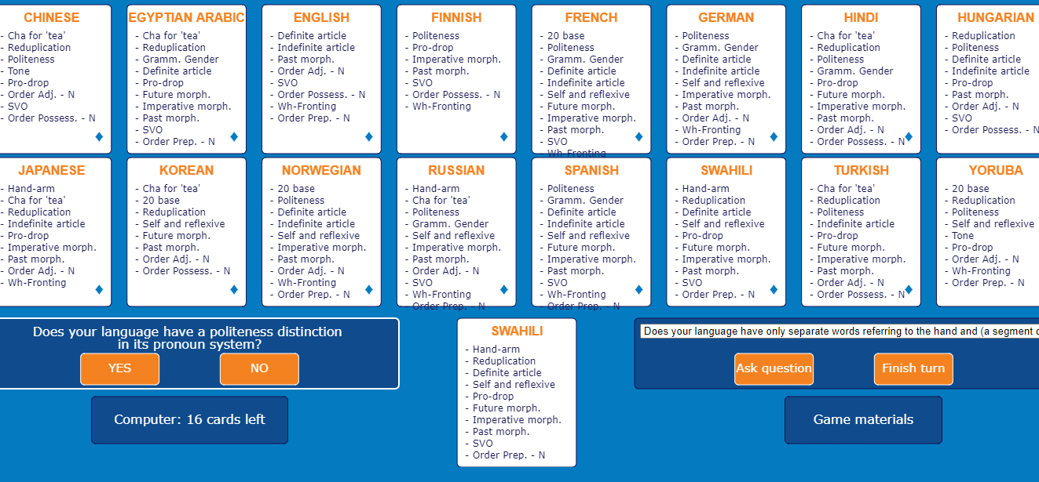
The components of the code 2/3
constants.js
Go to:
materials.html
style.css

Slide 5
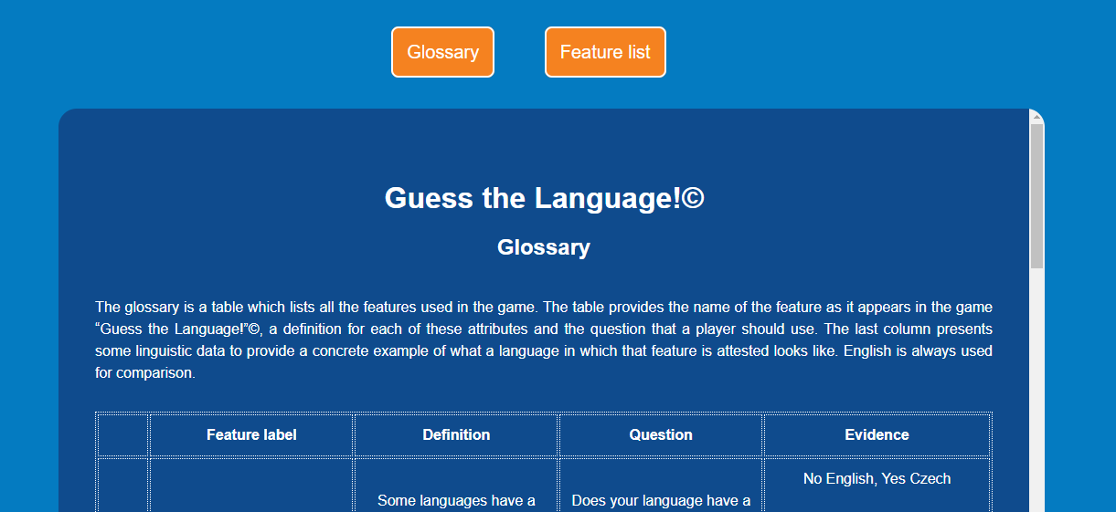
The components of the code 3/3
glossary.html
featurelist.html
materials.html
style.css

Slide 6
Constants.js
> Open With > Notepad++
It is strongly recommended that you download and use a source code editor like Notepad++ , as it will highlight different parts of the code for you and make it easier to navigate.
This is the only JavaScript file in the folder, and where all features and languages are stored along with all related information.
This file is the one that needs to be edited in order to add, remove or edit a language of the game.

Slide 7
How to create a personalized version of the game on your computer:
Download the file named “GuessTheLanguage.zip” from Moodle and unzip it.
In order to open/play the game: open the file named “index.html” in a Web browser of your choice, then click the “Start game” button.
In order to modify/add a language to the game: right-click on the file named “constants.js” and open it with Notepad++ or a similar code editor.
A STEP-BY-STEP GUIDE

Slide 8
const languages = [
{
"language": "Chinese",
"feat_hand_arm": false,
"feat_cha_for_tea": true,
"feat_20_base": false,
"feat_reduplication": true,
"feat_politeness": true,
"feat_grammatical_gender": false,
"feat_definite_article": false,
"feat_indefinite_article": false,
"feat_self_and_reflexive": false,
"feat_tone": true,
"feat_pro_drop": true,
"feat_future_morphology": false,
"feat_imperative_morphology": false,
"feat_past_morphology": false,
"feat_order_adj_n": true,
"feat_svo": true,
"feat_order_possessor_n": true,
"feat_wh_fronting": false,
"feat_order_preposition_n": false
},
Lines 1 to 124 contain the features of the game and all related information, whereas lines 126 to the end contain the languages and all related information.
Each feature and each language is stored as a single unit in between {}.
Information related to each unit consists of a number of attribute-value pairs, written as follows:
“attribute_name”: attribute_value,

Slide 9
NOTA BENE: the attribute name must be written between quotation marks, and the true or false value is written between quotation marks. The comma at the end of each line is mandatory, except for the last line. All lines contained between the comment marks /* and */ are commented lines, which will not be read by the browser while playing the game. To uncomment the lines, and make them readable by the browser, delete the marks.

Slide 10
SAVE the modifications, REFRESH the game page in your browser or open it again. If the procedure was done correctly, your language appears now in the bottom right corner of the board.
Delete the comment marks /* and */ before and after the portion of the code representing the language that you create .
Add comment marks /* and */ before and after the language that you want to replace.

Slide 11
As you can see, the last entry is currently empty. Complete all values with the information related to the language that you want to add. The value for the attribute “language” should be the name of YOUR language between quotation marks, while all other values should be either true, if your language presents this feature, or false, if your language does not have it.
Go to the end of the file constants.js, where the languages are represented as a single entry between {}.
REMEMVER: the quotation marks and the comma must end each line, except for the last one.

Slide 12
TROUBLESHOOTING:
If the “Start game” opens to a blank page, make sure that:
the name of the new language is written between quotation marks
the values for each of the features are either true or false in lower case
you have not deleted or forgotten any bracket, : sign or comma
If the language that was added is not displayed on the game page, make sure
that your language is uncommented (NOT between /* and */), and the language
that you want to replace is commented (MUST BE between /* and */).

Slide 13
Have Fun!
By the University of Geneva Upskills team:
Marie Berthouzoz, Margherita Pallottino, Genoveva Puskas

